Slide 1

Classification of
Swahili Proverbs.
A Comparative Study of NLP Methods
Belinda Mziray
HSLU MSc IT, Digitalization & Sustainability | 2026
Elimu ni bahari.
Literal Translation: Education is an ocean.

Slide 2
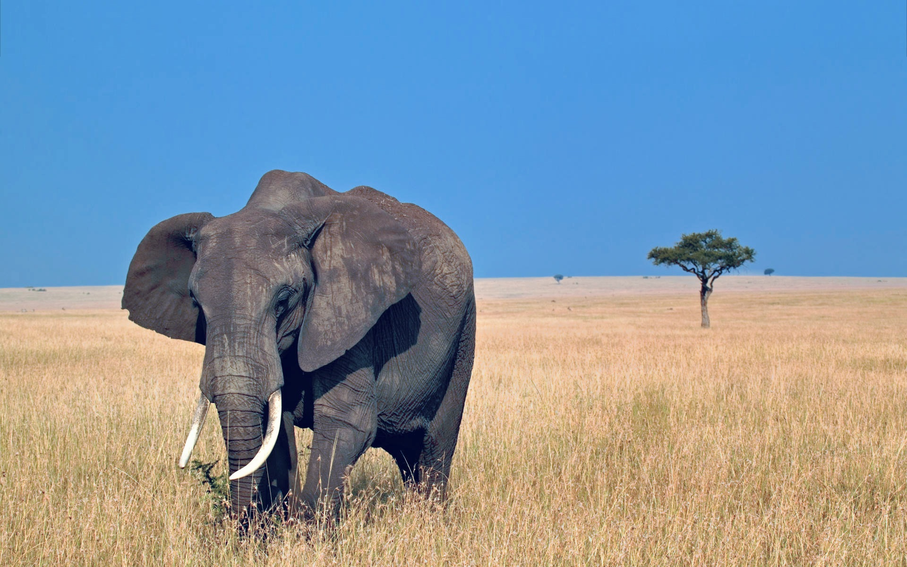
Presentation Outline
01
Problem & Dataset Context
02
Methods Overview: From Static to LLMs
03
Task Walkthrough and Results (Static, BERT, MLM, Llama)
04
The Challenge
05
Conclusion
06
Future Work & Recommendations
Kawia ufike.
Literal Translation: Delay so that you may arrive. (Better late than never)

Slide 3
The Swahili Proverb Dataset
5,060
56
Total Proverbs
Semantic Categories
Stratified Split
3,643
405
1,012
Training (70%)
Validation (10%)
Test (20%)
Key challenge:
Metaphorical text — surface words rarely match labels.
Class imbalance ranges from 5 to 200+ examples per category.
Haba na haba hujaza kibaba.
Literal Translation: Little by little fills the measure.

Slide 4

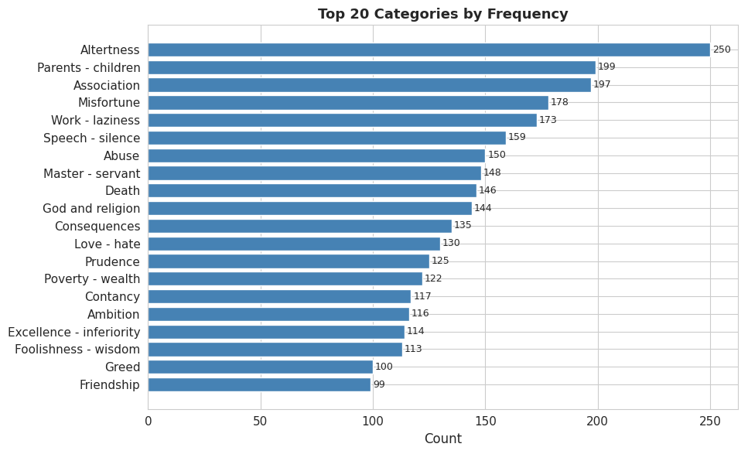

Slide 5
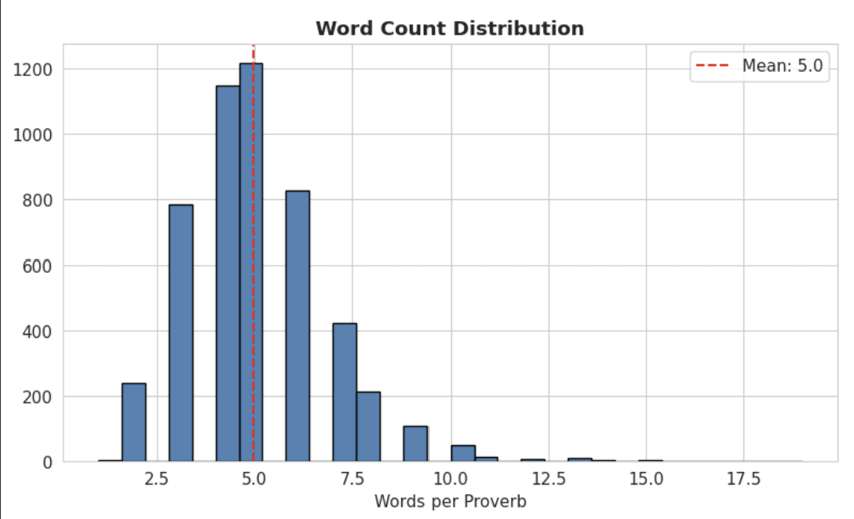

Slide 6
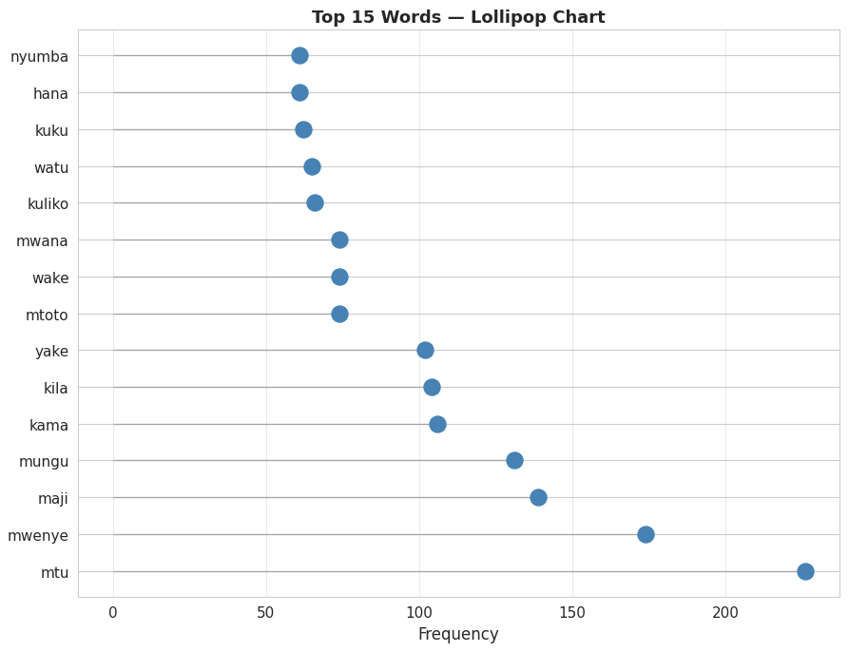

Slide 7
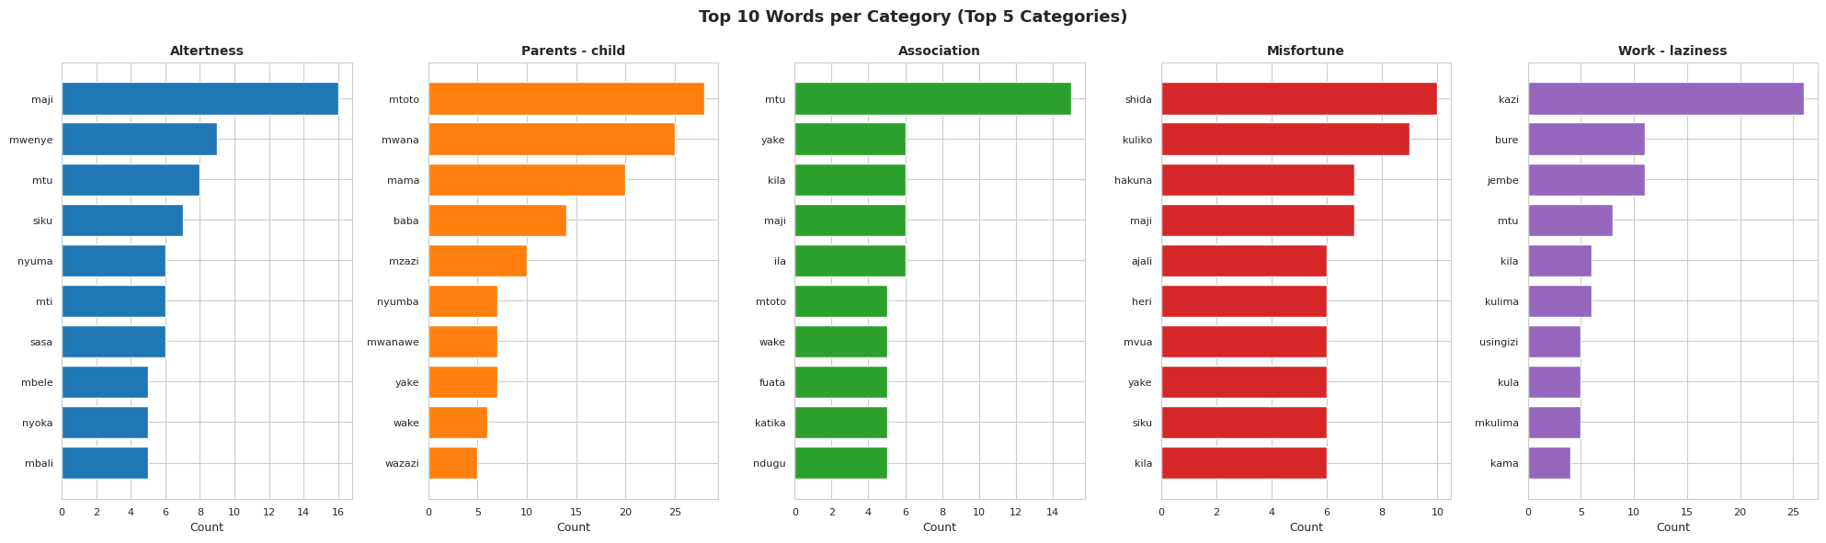

Slide 8
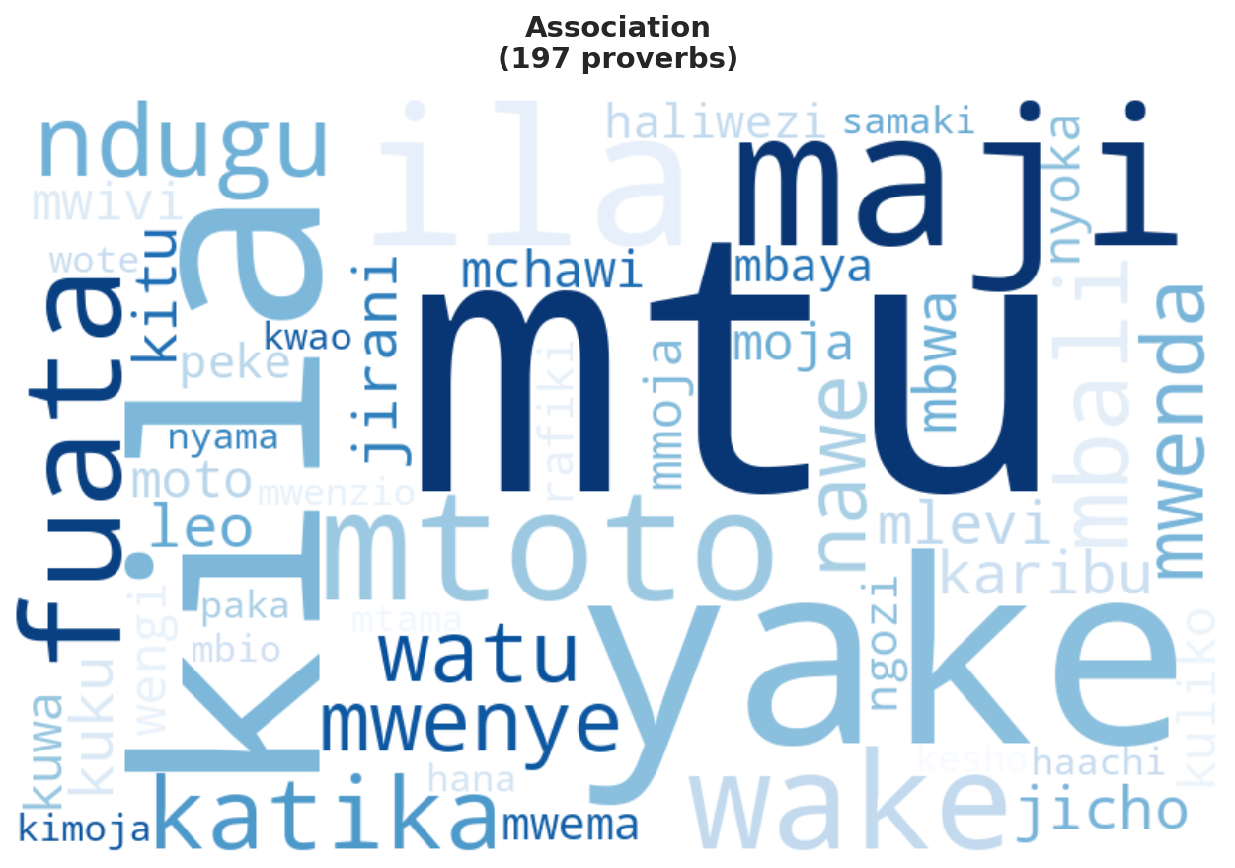
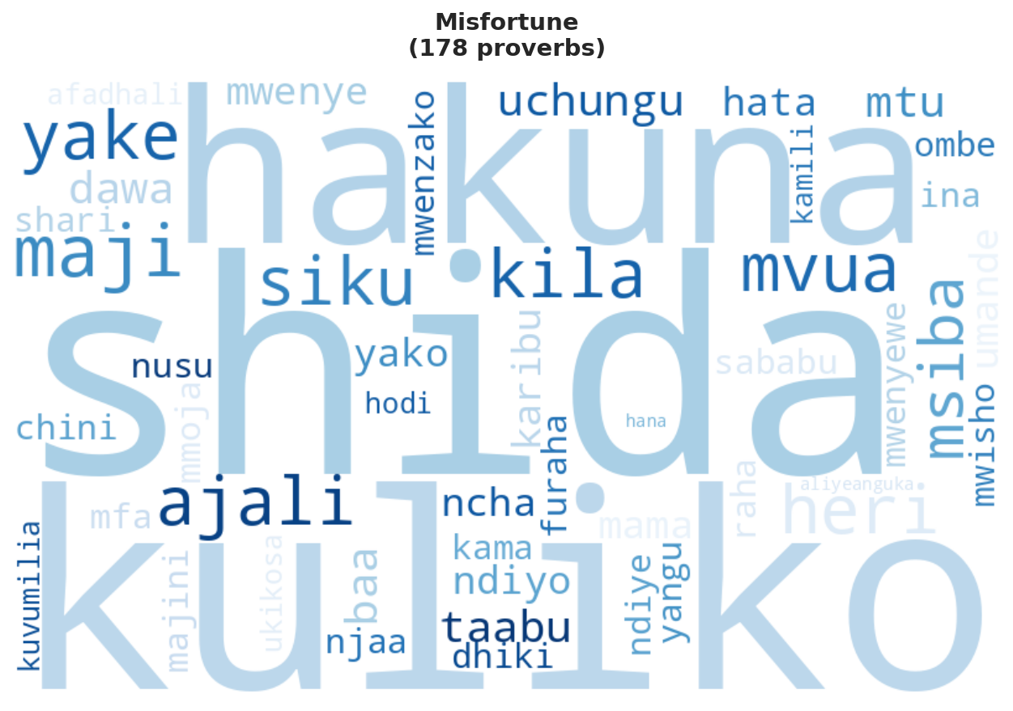
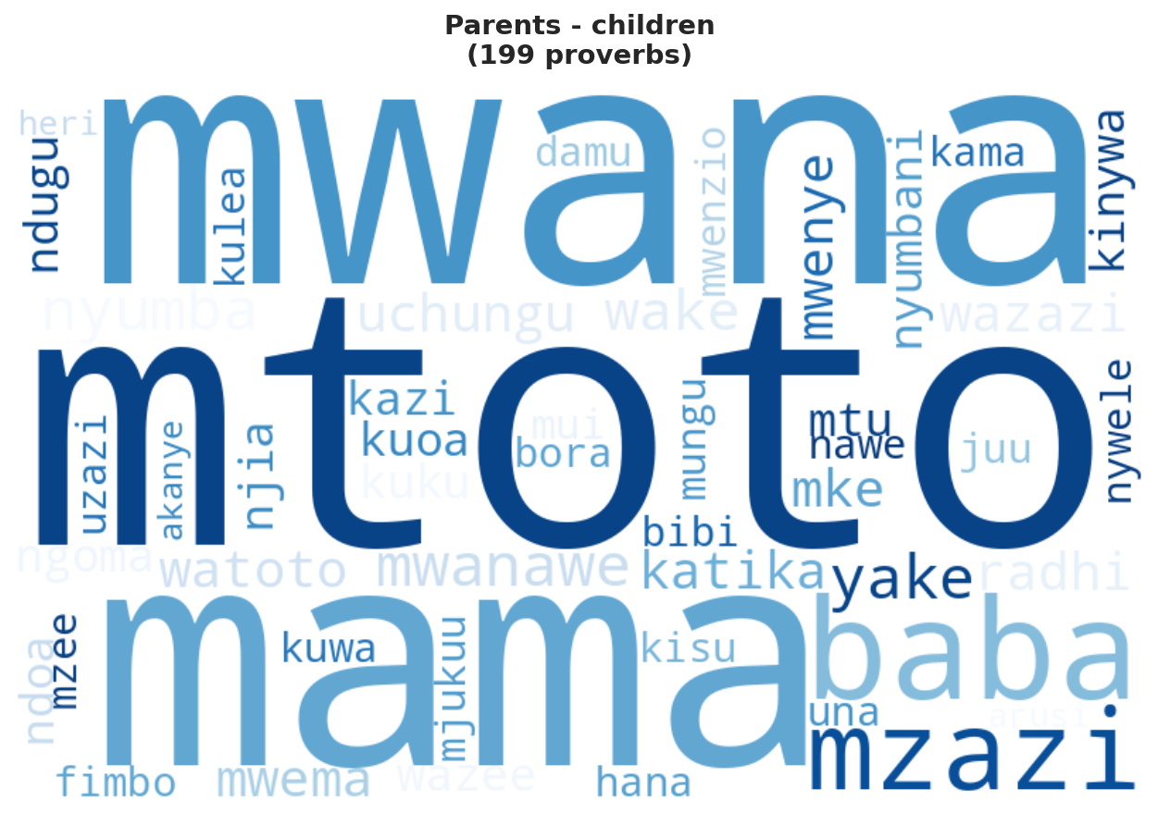
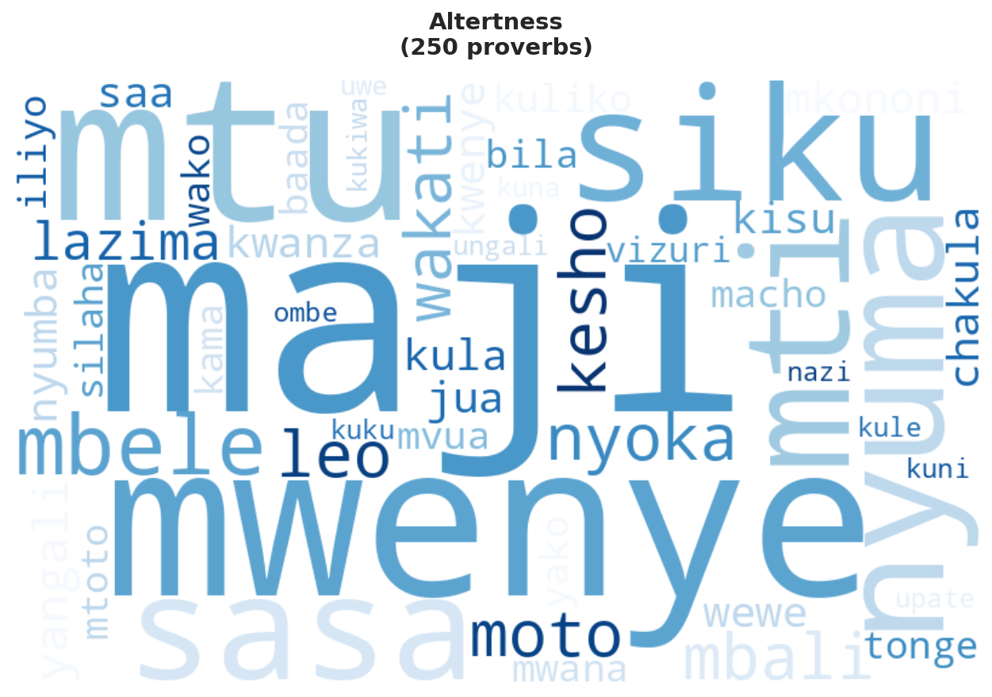

Slide 9
Four Classification Methods
Task
1
Task
2
Task
3
Task
4
Static
BERT
MLM
LLM
TF-IDF
Word2Vec,
FastText
Char N-grams.
Contextual learning
AfriBERTa
SwahBERT
DistilBERT-multilingual.
Contextual transfer learning
SwahBERT
DistilBERT-multilingual.
Llama-3-8B in
Zero-shot
Few-shot scenarios.
Pole pole ndio mwendo.
Literal Translation: Slowly slowly is the way to go.

Slide 10
Tools & Experiment Tracking
All experiments tracked across three platforms for redundancy and reproducibility.
Weights & Biases
Aim
MLflow
Cloud dashboards · Artifact storage · Shareable URLs
Open-source · Unlimited free · Fully local logging
Model registry · Industry standard · Self-hosted
Technical Stack
Clean Code Architecture
Platform
Google Colab + T4 GPU (15.6 GB)
Main training code is uncontaminated by tracking calls. All metrics, models, and artifacts logged in a single dedicated cell at the end of each notebook. Logs include: per-epoch train_loss · val_acc · val_f1 · test metrics · hyperparameters · model checkpoints · prediction tables.
Storage
Google Drive + gdown
Deep Learning
PyTorch 2.x
Transformers
HuggingFace Transformers
Classical ML
scikit-learn
Embeddings
Gensim (Word2Vec, FastText)
Mtaalamu hupimwa kwa kazi yake.
Literal Translation: An expert is measured by their work.

Slide 11
Task 1: Static Embeddings Results
Shared Classifier: Linear(input→128) → ReLU → Linear(128→56) · CrossEntropyLoss · Adam(lr=0.001) · 50 epochs
Finding
TF-IDF wins (24.0% / 22.0%) Word2Vec/FastText underperform: the 5,060-proverb corpus is too small for dense embeddings to converge.
Mchuma jasho hulia kivulini.
Literal Translation: One who sweats in the sun eats in the shade. (Hard work pays off)

Slide 12
Task 2: BERT Fine-tuning Results
AfriBERTa Leading
AfriBERTa
20.2%
Cross-lingual transfer from 11 African languages — best result.
SwahBERT
15.5%
Monolingual Swahili pretraining — solid second.
DistilBERT
14.4%
Generic multilingual — 10 epochs needed to converge.
Akili ni nywele, kila mtu ana zake.
Literal Translation: Intelligence is like hair; everyone has their own.

Slide 13
Task 3: MLM Domain Adaptation
Masked Language Modeling (15% mask) adapts pretrained models to the proverb domain before classification fine-tuning.
MLM Adaptation Gains
AfriBERTa-Large
(more capacity to specialize)
+1.28%
+1.45%
accuracy
F1
SwahBERT
(already Swahili-specialized)
+0.49%
+1.16%
accuracy
F1
Maji yakimwagika hayazoleki.
Literal Translation: Spilled water cannot be gathered up.

Slide 14
Task 4: Llama-3 Prompting Results
Llama-3-8B-Instruct classifies proverbs with no parameter updates — only prompt engineering.
Zero-Shot
BEST PERFORMER
Few-Shot
Accuracy
F1
Accuracy
F1
20.0%
21.1%
15.0%
8.9%
Prompt contains all 56 category names. Model classifies via internal semantic reasoning across the full label space.
2 example proverbs per category for 10 of 56 categories (context length limit). Bias toward exemplified classes hurts coverage of the remaining 46.
Zero-shot WINS — providing examples for only 10/56 categories biased the model.
Maneno matupu hayajengi nyumba.
Literal Translation: Empty words do not build a house.

Slide 15
Full Comparison: All Methods
13 methods across
Kuishi kwingi ni kuna mengi
Literal translation: Livng long is exoeriencing life

Slide 16

The Challenge: The Metaphor Problem
The fundamental challenge for ALL models is the semantic gap between proverb text and abstract category labels.
“Aigaye tembo kunya hupasuka msamba"
Literal: Doing things beyond your means can be detrimental
Semantic Category:
No surface word in the proverb refers to being within means.
Kivuli cha fimbo hakimficha mtu jua.
Literal Translation: The shadow of a stick does not hide a person from the sun.

Slide 17
Conclusion
1
Simple may be best
2
Language Specificity Matters
TF-IDF (24%) beats all other complex methods.
With ~65 training examples per class, transformers cannot fully exploit their capacity.
AfriBERTa > SwahBERT > DistilBERT. Cross-lingual transfer from related Bantu languages outperforms generic multilingual pretraining.
3
MLM Adaptation is Reliable
4
LLMs Match Fine-tuning
Domain-adaptive pretraining consistently improves results.
A single extra epoch of MLM adds meaningful, consistent value.
Llama-3 zero-shot (20% acc, 21% F1) matches fine-tuned BERT.
Penye nia pana njia.
Literal Translation: Where there is a will, there is a way.

Slide 18

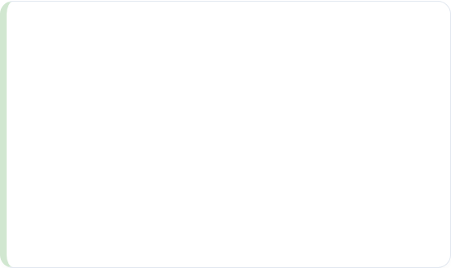
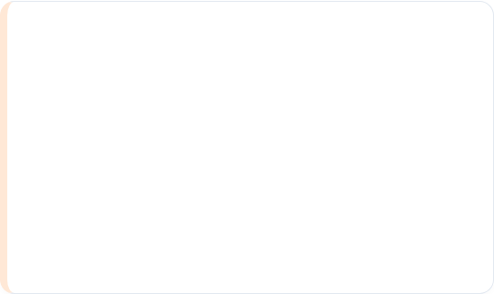


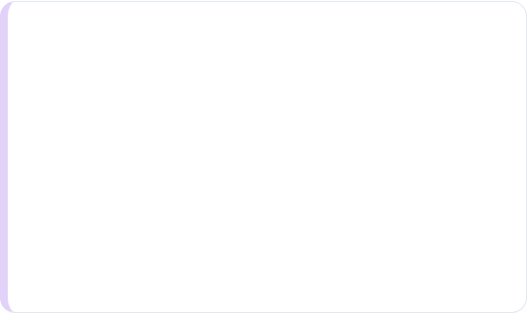


Future Research
Ensemble Architectures
Data Augmentation
Combine TF-IDF lexical weights with BERT contextual embeddings to capture both surface-level and structural semantics.
Implement further preprocessing using synonym substitution or proverb paraphrasing to expand the low-resource dataset.
Use Contrastive Learning
QLoRAFine-tuning
Training similar proverbs in pairs or groups that carry identical semantics t force models to learn underlying meanings.
Adapt Llama-3-8B with the full training set specifically for proverb-levl patterns to improve metaphorical reasoning.
Umoja ni nguvu, utengano ni udhaifu.
Literal: Unity is strength, division is weakness.

Slide 19
Thank you
Belinda Mziray
Questions?
Kilicho na mwanzo kina mwisho
Literal Translation: All must come to an end

